Slide 1
CSP 554 Big Data Technologies
Module 1b
Distributed System Concepts

Slide 2
Topics
Distributed System Concepts
Most big data technology is underpinned by distributed systems
We will explore the nature, advantages, disadvantages and also the architecture of these systems
Failure Modes in Distributed Systems
Distributed systems while beneficial in enhancing our ability to handle big data introduce a range of unique failure modes
We will review the categories of failures to which distributed systems are subject (against which big data software must compensate)

Slide 3
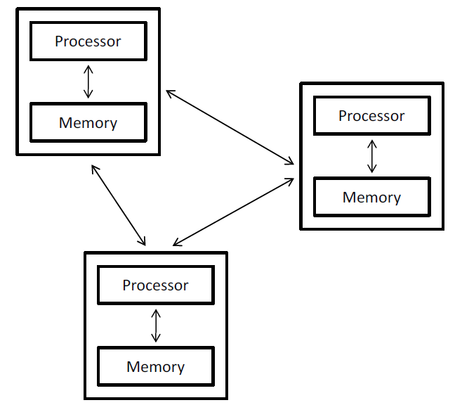
Distributed System: Definition
A collection of independent computers (nodes) that appears to its users as a single coherent system
Computers in distributed systems don’t share memory, CPUs or clock and relay information over a communication medium
Location A
Location B

Slide 4
What Does Coherent System Mean?
Access transparency: enables local and remote resources to be accessed using identical operations.
Location transparency: enables resources to be accessed without knowledge of their physical or network location (for example, which building or IP address).
Concurrency transparency: enables several processes to operate concurrently using shared resources without interference between them.
Replication transparency: enables multiple instances of resources to be used to increase reliability and performance without knowledge of the replicas by users or application programmers.

Slide 5
What Does Coherent System Mean?
Failure transparency: enables the concealment of faults, allowing users and application programs to complete their tasks despite the failure of hardware or software components.
Mobility transparency: allows the movement of resources and clients within a system without affecting the operation of users or programs.
Performance transparency: allows the system to be reconfigured to improve performance as loads vary.
Scaling transparency: allows the system and applications to expand in scale without change to the system structure or the application algorithms.

Slide 6
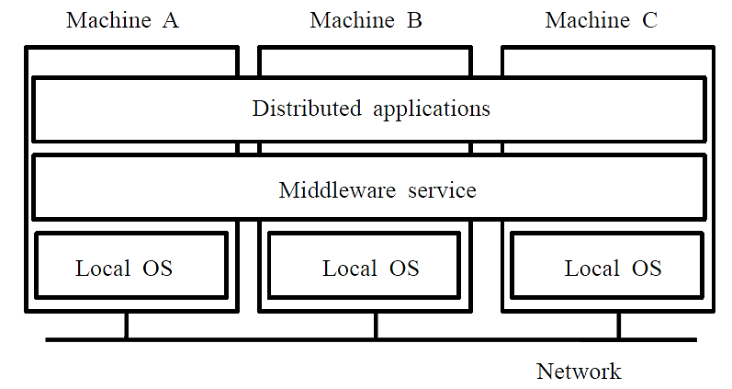
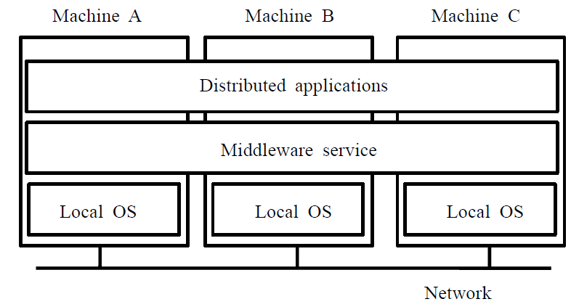
Distributed System Architecture
Independent computers and coherent system => middleware

Slide 7
Distributed System Advantages
Distributed computing systems offer a better price/performance ratio than centralized systems
Redundancy increases availability when parts of a system fail
Applications that can be parallelized also offer benefits in terms of faster performance vis-à-vis centralized solutions
Distributed systems can be extended through the addition of components, providing better scalability compared to centralized systems

Slide 8
Distributed System Challenges
Building reliable systems from unreliable components
Nodes fail independently
A distributed system can “partly fail”
Unreliable network communication
Administration issues
Placing data and computation for effective resource sharing, hiding latency
And finding data/results again once you put it somewhere
Managing coordination and shared state
What should the system components do and when should they do it?
Once they’ve all done it, can they all agree on what they did and when?

Slide 9
Distributed System Challenges
Troubleshooting and diagnosing problems in a distributed system can also become more difficult
The analysis may require connecting to remote nodes or inspecting communication between nodes.
Many types of computation are not well suited for distributed environments
Typically owing to the amount of network communication or synchronization that would be required between nodes
If bandwidth, latency, or communication requirements are too significant, then the benefits of distributed computing may be negated
Performance may be worse than a non-distributed environment

Slide 10
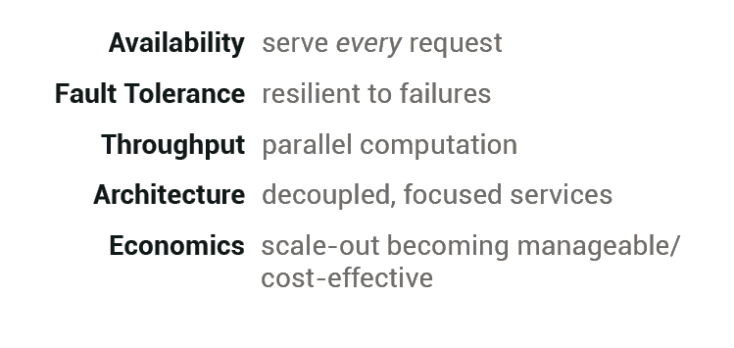
Why Distributed Systems

Slide 11
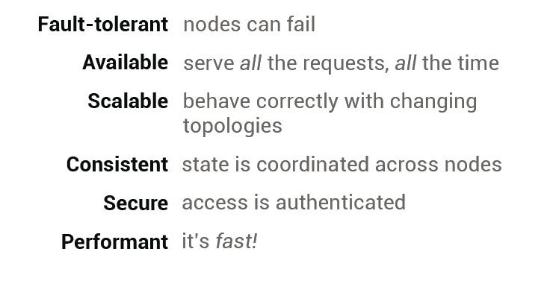
Reliable Distributed Systems

Slide 12
Scalability
Scalability is sometimes defined as "the ease with which a system or component can be modified to fit the problem area."
A scalable system has three simple characteristics:
The system can accommodate increased usage,
The system can accommodate an increased data set,
The system is maintainable and works with reasonable performance

Slide 13
Scalability Types
Vertical scaling, where you scale by adding more resources, like CPU, memory, or storage to a single system.
Horizontal scaling, where you scale by adding more machines.

Slide 14
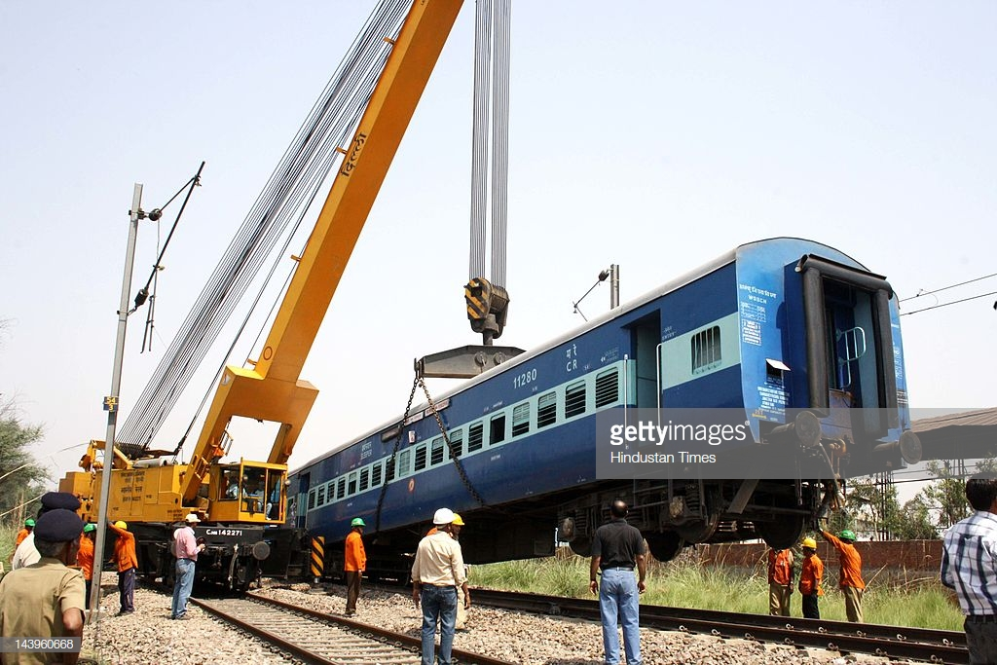
One Way to Do Heavy Lifting
Scaling Up: if the train car is too heavy find a bigger crane

Slide 15
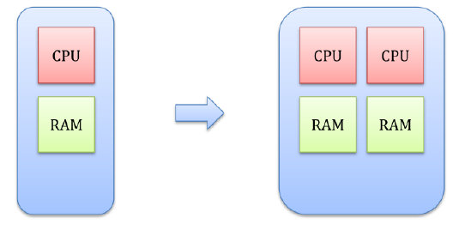
Scaling Up (Vertical Scaling)
Refers to resource maximization of a single unit to expand its ability to handle increasing load.
In hardware terms, this includes adding processing power and memory to the physical machine running the server.
In software terms, scaling up may include optimizing algorithms and application code.

Slide 16
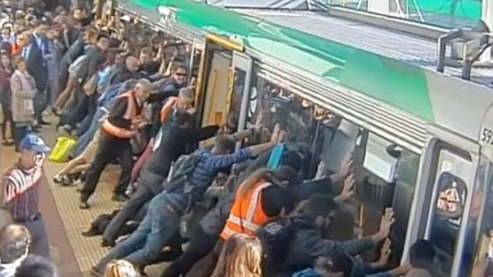
Another Way to Do Heavy Lifting
Scaling Out: if the train car is too heavy find lots more people

Slide 17
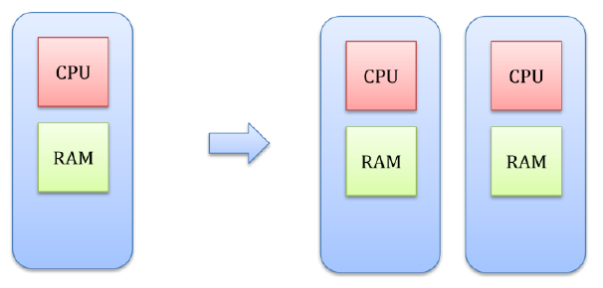
Scaling Out (Horizontal Scaling)
Refers to resource increment by the addition of units to the system.
This means adding more units of smaller capacity instead of adding a single unit of larger capacity.
The requests for resources are then spread across multiple units thus reducing the excess load on a single machine.

Slide 18
Horizontal Scalability Advantages
Real driving forces behind the trend toward scale-out are semiconductor physics and economics
Over a quarter of a century ago, Herb Grosch stated :The computing power of a CPU is proportional to the square of its price.
By paying twice as much, you could get four times the performance.
This observation fit the mainframe technology of its time quite well, and led most organizations to buy the largest single machine they could afford.
With microprocessor technology, Grosch's law no longer holds.
For a few hundred dollars you can get a CPU chip that can execute more instructions per second than one of the largest 1980s mainframes.
But if you are willing to pay twice as much, you get the same CPU, running at a somewhat higher clock speed (physics limitations)
So the most cost-effective solution is to harness a large number of (relatively) cheap CPUs together in a system.

Slide 19
Horizontal Scalability Challenges
Parallelize the workload across the various machines
Consistent, shared view of the entire data set
Handle distributed concurrency and consistency
Minimize the amount of coordination overhead

Slide 20
Scale-Out Today
A well architected collection of microprocessors yields an absolute performance that no mainframe can achieve at any price
With current technology it is possible to build a system from 10,000 modern CPU chips, each of which runs at 50 MIPS, for a total performance of 500,000 MIPS.
No existing machine even comes close to this, and both theoretical and engineering considerations make it unlikely that any machine ever will

Slide 21
Shared Everything Storage
Storage Area
Network

Slide 22
Shared Nothing Storage

Slide 23
Mixed Mode Storage
Storage Area
Network

Slide 24


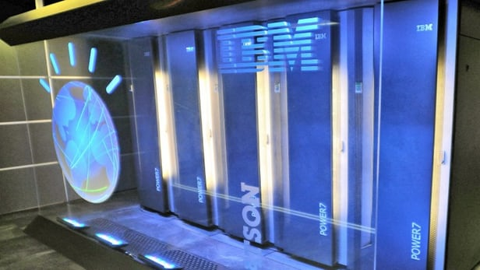
Cluster: Definition
Cluster is a special case of distributed system
Defining feature of a cluster is tight coupling between computers in the system
Typically located next to each other and connected via high-speed network
The fastest supercomputers in the world are clusters
Composed of many 1000’s of microprocessors or GPUs located in a single data center
The primary approach to handling big data

Slide 25
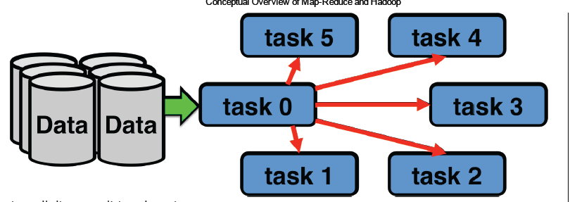
Traditional Distributed Computing Pattern
CPU bound, not I/O or data bound
Strategy: Move data to processing

Slide 26
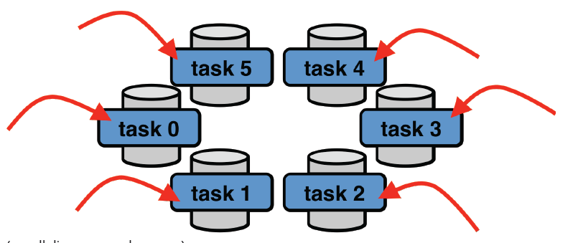
Big Data Distributed Computing Pattern
I/O or data bound, not CPU bound
Strategy: Move processing to data

Slide 27
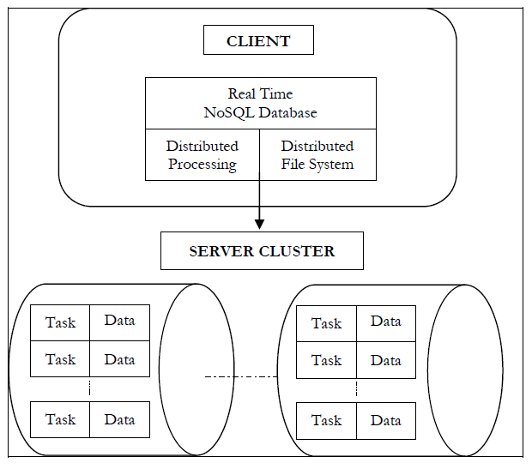
Big Data Clusters

Slide 28
Distributed System: Definition
A distributed system is a system in which I can’t get my work done because a computer that I’ve never heard of has failed.
-- Butler Lampson

Slide 29
Cloud Computing
Distributed systems as a utility service
Enables convenient, on-demand Internet access to a shared pool of configurable computing resources
(e.g., networks, servers, storage, applications, and services)
Resources can be rapidly provisioned and released with minimal management effort or service provider interaction

Slide 30

Cloud Computing
Resources are accessible through
APIs or Web UIs exposed via the
Internet
APIs
Resources
Compute
Storage
Network
Services
Security
Internet
Web UI

Slide 31
Cloud Computing: Essential Characteristics
Speed and Agility
Elastic Capacity
Multiple Tenancy
Pay-as-you-go
Innovative Services
Big Data Support
Resources
Compute
Storage
Network
Services
Security

Slide 32
Definitions
A system failure is a deviation from the service that the system is supposed to provide (visible to users)
An error is an incorrect value of the system state which can provoke a failure
Finally a fault is a defect in the design or in the operation of the system that may cause an error.
Faults can be transient (one time), intermittent (occasional) or persistent (remain until repaired)
Fault
Error
Failure
Cause of failure
A state that may lead to failure
Service departs from spec
Design
Component

Slide 33
Reliability Concerns
Availability
Can I use it now?
Reliability
Will it be up as long as I need it?
Safety
If it fails, what are the consequences?
Maintainability
How easy is it to fix if it breaks?

Slide 34
Other Reliability Notes
A fault need not result in an error, nor an error in a failure.
A non-faulty component will produce an output that is in accordance with this specification.
The response from a faulty component need not be as specified, i.e., it can be anything.
The response from a given component for a given input will be considered to be correct
If the output value is correct
The output is produced on time, i.e., produced within a specified time limit.
An alpha particle corrupting a memory location is a fault. If that memory location contains data, that corrupted data is an error. If a program crashes because of using that data, it is a failure.

Slide 35
Possible Failures in Distributed Systems
Data corruption
Hanging processes
Misleading return values
Misbehaving computers
Network outages
Hardware failures
Insufficient resources

Slide 36
Failure Modes
Type of Failure | Description
Crash failure | A server halts, but is working until it halts
Omission failure Receive omission……….. Send omission…………... | A server fails to respond to incoming requests A server fails to receive incoming messages A server fails to send outgoing messages
Timing failure | A server’s response lies outside the specified time interval
Response failure Value failure……………... State transition failure….. | The servers response is incorrect The value of the response is wrong The server deviates from correct flow of control
Arbitrary failure | A server may produce arbitrary responses at arbitrary times

Slide 37
Omission Failure
A component that does not respond to an input from another component, and thereby fails by not producing the expected output is exhibiting an omission fault and the corresponding failure an omission failure.
A communication link which occasionally loses messages is an example of a component suffering from an omission fault.

Slide 38
Value Failure
A fault that causes a component to respond within the correct time interval but with an incorrect value is termed a value fault (with the corresponding failure called a value failure).
A communication link which delivers corrupted messages on time suffers from a value fault
A memory, disk or software error could also lead to a value failure

Slide 39
Timing Failure
A timing fault causes the component to respond with the correct value but outside the specified interval (either too soon, or too late). The corresponding failure is a timing failure.
An overloaded processor which produces correct values but with an excessive delay suffers from a timing failure. Timing failures can only occur in systems which impose timing constraints on computations.

Slide 40
Arbitrary Failure
The previous failure classes have specified how a component can be considered to fail in either the value or time domain.
It is possible for a component to fail in both the domains in a manner which is not covered by one of the previous classes.
A failed component which produces such an output will be said to be exhibiting an arbitrary failure (AKA, Byzantine failure).
Sometimes called malicious failure because it includes
Two-faced behavior; the affected system can send a message “fact X is true” to one user and “fact X is false” to another user
Spoofing behavior; Forging of messages of other systems

Slide 41
Fault Tolerance
The property that enables a system to continue operating properly (from the perspective of the user) in the event of one or more faults or errors
Big data technology must address fault tolerance in one way or another (through software and/or hardware)
Recovery or Compensation Mechanism
Fault
Error
Failure
Cause of failure
A state that may lead to failure
Service departs from spec
Design
Component
X
X

Slide 42
Distributed Systems Summary
Users of big data have to accept that data needs to be distributed
Storing and processing datasets across a cluster of machines is unavoidable
Once a cluster become the storage and analysis foundation then software has to account for failure
Because failure is inevitable when you're talking about running hundreds or thousands of machines in a cluster.
Finally, analysis logic needs to go to the data and process it on the distributed machines
Rather than moving the vast quantities of data across the network.

